Slide 1


Progress Report 2019 UNISHK
Prof. dr.Arjeta Troshani
University of Shkodra “Luigj Gurakuqi”
11.12.2019

Slide 2
Activities 2019 - MARDS
Preparation of Progress Report and distribution to all Albanian Partners 11.11.2019
Meeting with Economic Faculty members and approval of the PR on 13.11.2019
Organization of the Second Meeting with Albanian Partners

Slide 3
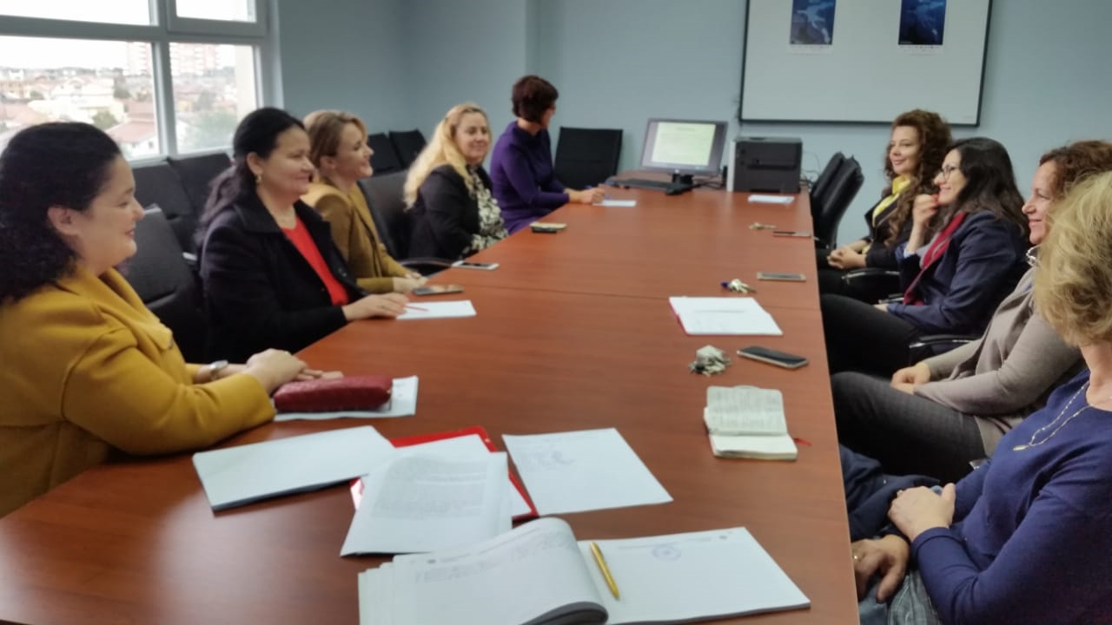

Slide 4
Minutes of the Second Meeting with UNISHK team 18.11.2019

Slide 5
Activities 2019 - MARDS
Meeting with stakeholders: Tourism Businesses, Staff and Prospective Students of PhD school 18.11.2019
Letter of Rector send to MASR (31.10.2019) and the answer (14.11.2019)

Slide 6
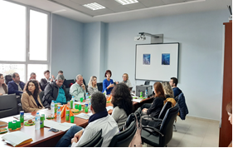
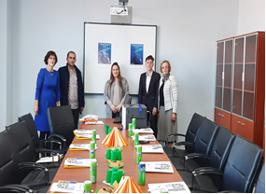
Meeting with Tourism Businesses

Slide 7
Presentation and approved by UNISHK Senate
On 22nd November it was presented by prof. Brilanda Bushati the MARDS Progress Report and it was approved unanimously for further measures to be taken.

Slide 8
Minutes of Senate Meeting for the approval of MARDS Progress Report
22.11.2019

Slide 9
Scanned Document of the report send to Education Ministry, UNISHK Senate, Rector, Administrator, Dean, IRO office

Slide 10
Bilateral Agreements
UNIV already signed by both Rectors
UPT to be done
UMT to be done
CCI signed by UNISHK Rector
UCG is already signed by two Rectors

Slide 11
Draft Curricula of PhD discussed with UNISHK team
“Economics and Sustainable Tourism”
Basic Courses (fields of scientific research): 30 ECTS
Advanced Strategic planning of touristic destinations (UNISHK, UP, UCG) 7 ECTS ( 75 hours)
Economics of sustainable development (UNISHK, UV, UCG) 7 ECTS ( 75 hours)
Advanced Research Methods (UNISHK, UV, UMT, UP) 7 ECTS ( 75 hours)
Management of sustainable tourism (UNISHK, UV, UP, UCG) 9 ECTS (75 hours)

Slide 12
Draft Curricula of PhD
“Economics of Sustainable Tourism”
Elective courses (UNISHK, UPT, UMT, UCG, UV) 30 ECTS
1. Management of biodiversity, (UNISHK, UV, UCG) 9 ECTS
2. Management of Project Management, (UNISHK,UCG) 7 ECTS
3. Information System in Tourism (UNISHK, UMT) 7 ECTS
4. Social entrepreneurship and Innovation (UNISHK, UP, UMT) 7 ECTS

Slide 13
Albanian Legal Framework
Udhezimi nr.31 date 29.12.2017
Akti i Themelit
Akti i Akreditimit
Marreveshja bashkepunimi ( ofrimi i programeve te perbashketa)
Marreveshje specifike per programin e perbashket per autoresine e syllabuseve,.. etj

Slide 14
Albanian Legal Framework
Ligji Nr.80 viti 2015
Doktoratura do bazohet ne projekt kerkimor qe prezantohen individualisht nga kandidati
Vendimi i K.M. nr.112 date 23.02.2018 per kriteret per fitimin e grades “Doktor”
Vendimi nr.41 date 24.01.2018 per elementet e programeve te studimit te ofruara nga IAL

Slide 15
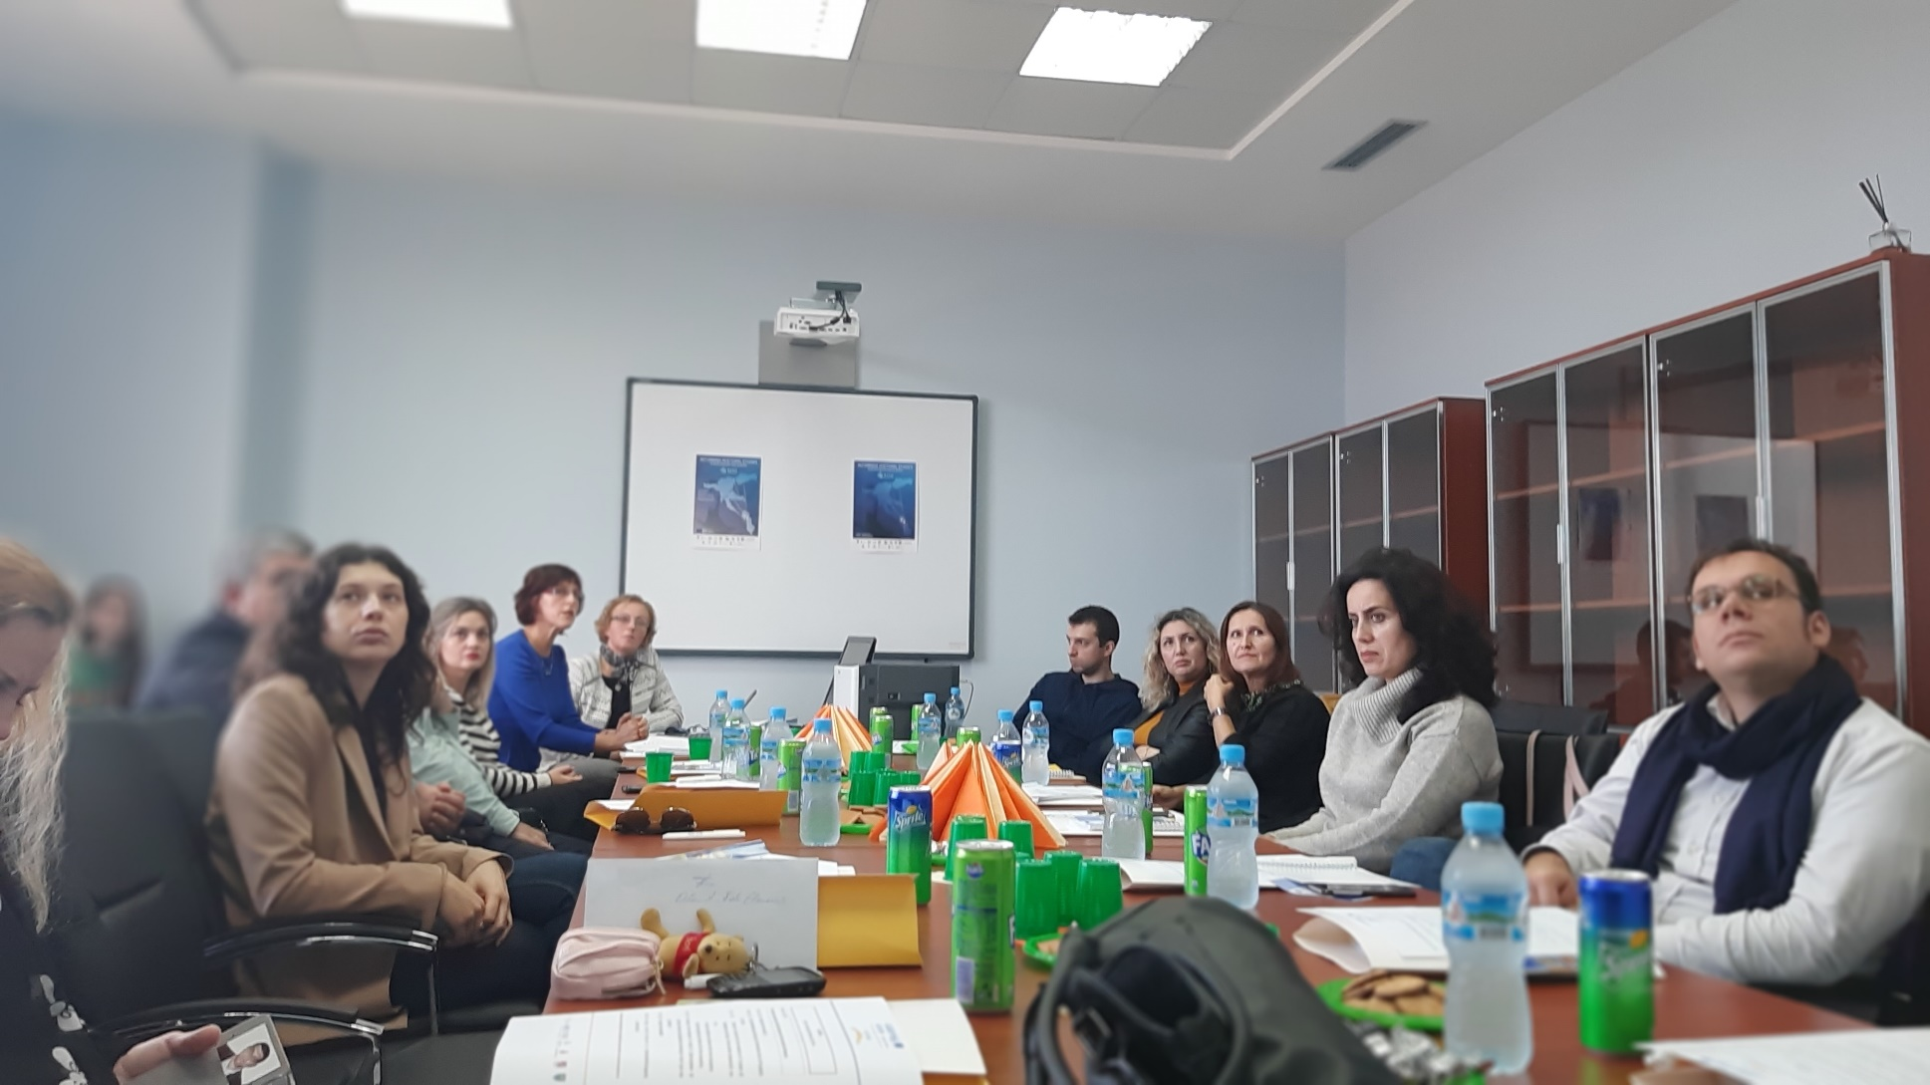
DISSEMINATION ACTIVITIES

Slide 16
Dissemination
Prepared a two page dissemination material in Albanian language for media and send to prof. Betim Cico on 19.11.2019.

Slide 17
Future Activities
Communication with MASR
Finalizing the PhD Curricula
Finalizing Bilateral Agreements
Finalizing Specific Agreement
Start the tender equipment and finish all payments.
Dissemination with local media

Slide 18

DISCUSSIONS and QUESTIONS

